Slide 1
Strategic Directions in Funding Innovation – An interactive session that will offer a dialogue on:
TTA/Grant Writing Training Synopsis
The Federal Funding Cycle
Philanthropic Outreach
Findyouthinfo.gov/grants.gov

Slide 2
U.S. Department of Housing and Urban Development in Conjunction with
The National Forum on Youth Violence Prevention
TTA/GRANT WRITING TRAINING SYNOPSIS
KNOW YOUR STORY
  What’s The Problem?
    What are the Causes?
    What is the Ideal State?
  What’s the Action Plan
  What are the Resources?

Slide 3
U.S. Department of Housing and Urban Development in Conjunction with
The National Forum on Youth Violence Prevention
KNOW YOUR FUNDER’S STORY
  Who are the Funders and what do they want in return for their money?
  What grants will allow us to fund our outputs and reach our outcomes while we meet the grant outputs and outcomes? They must align!
You’ve mastered your story
You’ve mastered the funders’ stories
And now……….

Slide 4
U.S. Department of Housing and Urban Development in Conjunction with
The National Forum on Youth Violence Prevention
KNOW HOW TO PUT THE STORIES TOGETHER
  Assets and Needs Assessments
  Environmental Scans
  The right mix of grants that reaches problem solution and meets funder expectations?
The End of The Story
Outcomes achieved and stakeholders satisfied
Self-sufficiency/grant independence

Slide 5
U.S. Department of Housing and Urban Development in Conjunction with
The National Forum on Youth Violence Prevention
Grant Writing Training | You have the Strategic Plan You know your organization’s mission and story and its role in the Strategic Plan You want assistance writing the most effective grant possible HUD delivers this training on Day 1
Federal Symposium | There is no “silver bullet,” no “one-grant-fits-all” Multi-faceted problems require multi-faceted solution sets YOU are the silo-buster: but we can help Site Cities tell us which Federal partners they want at the table Multi-media presentation: Live, Video, POTS if necessary – one way or the other, we will get you the information you need This occurs on Day 2
Optional Third Segment | We will facilitate discussion of topics of special interest to you, insofar as we can This occurs on Day 2
Total Conference Times Investment | 1 ½ to 2 days, depending on complexity Content-rich Fast-paced Interactive
HUD Center for Faith-Based and Neighborhood Partnerships
Call: 202-708-2404
Email: Partnerships@hud.gov

Slide 6
The Federal Funding Cycle
Planning (e.g. spring call, President’s budget, etc. . )
Appropriations (e.g. drafting solicitations)
Application Review (e.g. peer review process and office/agency discretion)
Award and Beyond
  FOIA

Slide 7
What Are You Getting Into
Different types of funding streams and programs
  Discretionary vs. formula or block
  Demonstration vs. replication
  Non-competitive awards – Forum Capacity Building Grants
    Leveraging Resources

Slide 8
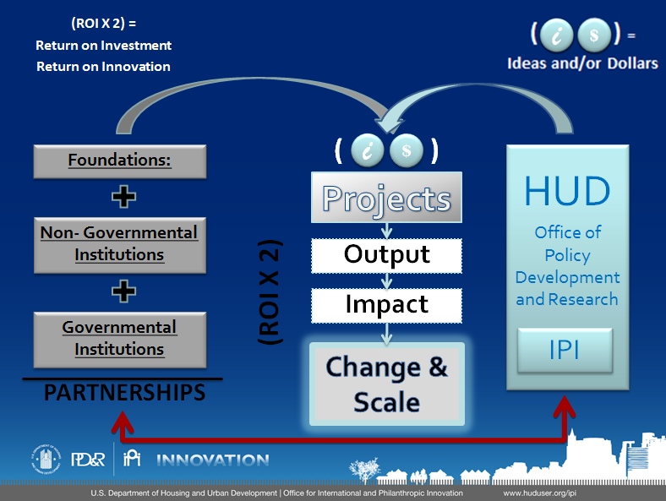
IPI DESIGN
Notes:
We’re on the right…partners on the left…both pushing into the middle to engage and collaborate on projects (through ideas and dollars) to increase output and impact and create change and scale for shared goals and missions.
8

Slide 9





Michigan's Office of the Foundation Liaison
  Council of Michigan Foundations
Philanthropic Liaison to the City of Newark
  Council of New Jersey Grantmakers
Similar offices in California, Colorado, and New Mexico…
Regional Associations of
Grantmakers in all 50 states
National Funder Associations:
  Council on Foundations (including 250+ Community Foundations)
  Neighborhood Funders Group
  The Funders Network for Smart Growth and Livable Communities
Notes:
Michigan’s Office of the Foundation Liaison
The OFL is funded by 13 foundations and supported by the state government.
OFL's Objectives:
1. Educate state officials about foundations
2. Forge relationships and support the development of partnerships between the state and foundations
3. Attract new national grant dollars to Michigan
4. Respond to opportunities for new local and regional public/private partnerships to serve people and the implementation of government programs
Since its inception, the OFL has brokered over $100 million in foundation investment in initiatives designed to help increase Michigan's economic competitiveness through reforms in:
K-16 Education
Economic Development, including Workforce Development
Health
Early Childhood
Land Use
Philanthropic Liaison to the City of Newark
In just over a year, the philanthropic liaison has brokered foundation gifts of $7.9 million to advance Newark
initiatives. The liaison used these funds to match and secure an additional $5.2 million in public funding, for total
support of $13.1 million. More leveraging power was realized through $13.5 million in Newark-focused State
resources from multiple agencies that had never before been identified, catalogued, and combined, helping secure
national funding. To date, the liaison has leveraged $26.6 million in private and public dollars in support of
programs for prisoner reentry, greening and sustainability, child and family well-being, and economic development.

Slide 10




Choice Neighborhoods
Strong Cities,
Strong Communities (SC2)
Promise
Neighborhoods
Partnership for Sustainable Communities
Neighborhood Revitalization Initiative
Notes:
Choice Neighborhoods
Implementation: Boston, San Francisco, Chicago, Seattle, New Orleans
Planning: Over 30 more
Strong Cities Strong Communities:
Detroit
Memphis
Fresno
New Orleans
Cleveland
Chester, PA

Slide 11
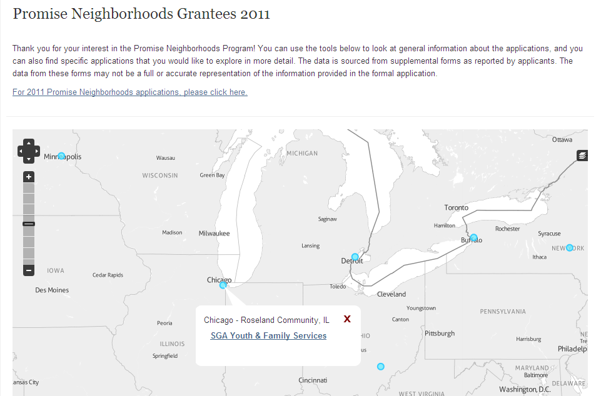
data.ed.gov

Slide 12

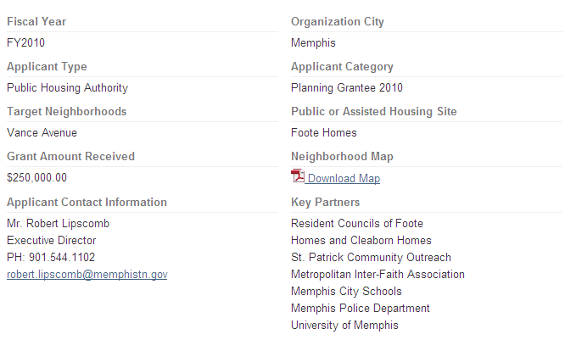
partner.hud.gov

Slide 13
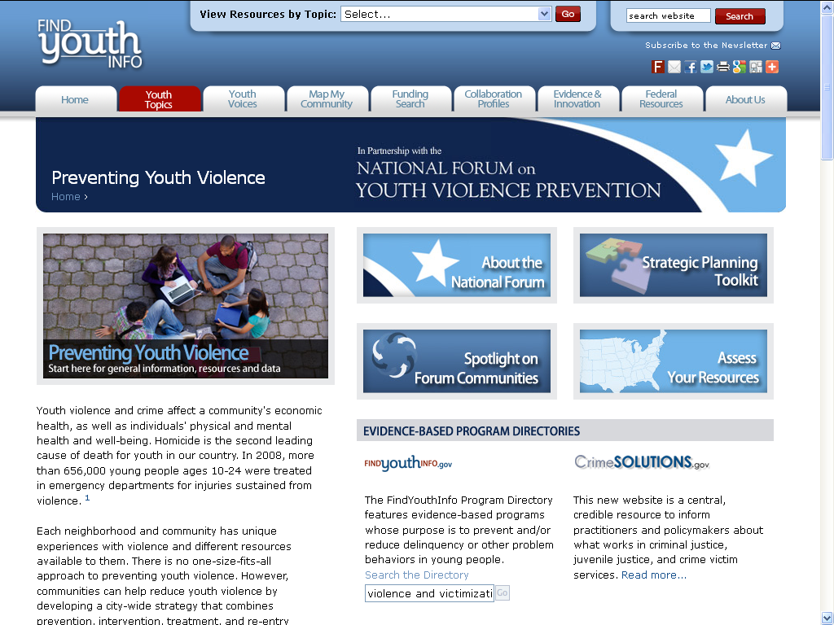
Preventing Youth Violence website
Notes:
Here is the website for the Forum – hopefully you’ve all seen this before. The page has just been updated to include the Toolkit. The page is part of FindYouthInfo.gov, so it’s connected to lots of other helpful announcements and information on youth violence and other related topics, like transition age youth, youth employment, mentoring, etc.

Slide 14
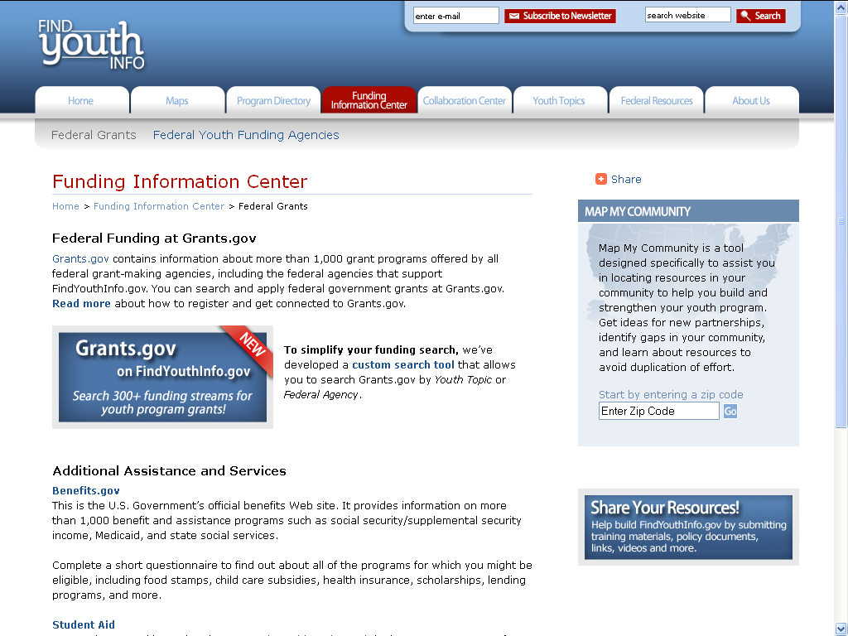
Updated Preventing Youth Violence website offering a search of open grant olicitations
The new custom search of grants.gov will help you find open solicitations for youth programs.
Notes:
We have recently updated the site to offer a search of open grant solicitations. If you click on the “Funding Information Center” tab, you’ll go right to this screen. We think you’ll be really excited about this update. If you’ve been to grants.gov. you know that typing “youth” into the search box leads to a LOT of results, many of which are not relevant. The Funding Information Center page on FindYouthInfo.gov has a lot of resources to help you strengthen your grant applications, but now we’ve brought the relevant open solicitations right to you! You can use this custom search tool to search Grants.gov for youth-relevant grants.

